Slide 1
UNIT-2: Requirement Analysis and Specification
Requirements Engineering,
Establishing the Groundwork,
Eliciting Requirements,
Developing Use Cases,
Building the Requirements Model,
Negotiating Requirements,
Validating Requirements,
Requirements Analysis.
TEXT-BOOK:RSP 8/e Section 8.1 to 8.6,8.8 and 9.1

Slide 2
Requirements Engineering-I
Understanding Requirements
Inception
—ask a set of questions that establish …
  basic understanding of the problem
  the people who want a solution
  the nature of the solution that is desired, and
  the effectiveness of preliminary communication and collaboration between the customer and the developer.

Slide 3
Requirements Engineering-I….
Elicitation—elicit requirements from all stakeholders
Elaboration—create an analysis model that identifies data, function and behavioral requirements
Negotiation—agree on a deliverable system that is realistic for developers and customers

Slide 4
Requirements Engineering-II
Specification
—can be any one (or more) of the following:
  A written document
  A set of models
  A formal mathematical
  A collection of user scenarios (use-cases)
  A prototype

Slide 5
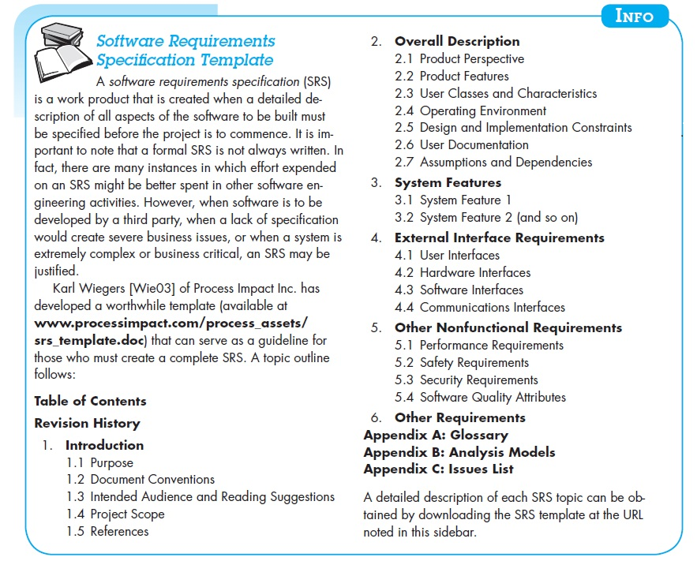

Slide 6
Requirements Engineering-II….
Validation—a review mechanism that looks for
  errors in content or interpretation
  areas where clarification may be required
  missing information
  inconsistencies (a major problem when large products or systems are engineered)
  conflicting or unrealistic (unachievable) requirements.
Requirements management

Slide 7
Inception
Identify stakeholders
  “who else do you think I should talk to?”
Recognize multiple points of view
Work toward collaboration
The first questions
  Who is behind the request for this work?
  Who will use the solution?
  What will be the economic benefit of a successful solution
  Is there another source for the solution that you need?

Slide 8
Eliciting Requirements
Collaborative Requirements Gathering
meetings are conducted and attended by both software engineers and customers
rules for preparation and participation are established
an agenda is suggested
a "facilitator" (can be a customer, a developer, or an outsider) controls the meeting
a "definition mechanism" (can be work sheets, flip charts, or wall stickers or an electronic bulletin board, chat room or virtual forum) is used
the goal is
  to identify the problem
  propose elements of the solution
  negotiate different approaches, and
  specify a preliminary set of solution requirements

Slide 9
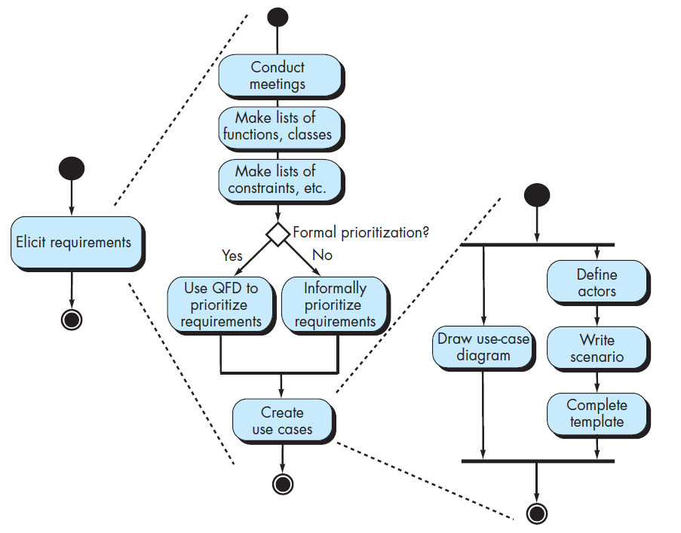
Eliciting Requirements

Slide 10
Quality Function Deployment
Function deployment determines the “value” (as perceived by the customer) of each function required of the system
Information deployment identifies data objects and events
Task deployment examines the behavior of the system
Value analysis determines the relative priority of requirements

Slide 11
Elicitation Work Products
a statement of need and feasibility.
a bounded statement of scope for the system or product.
a list of customers, users, and other stakeholders who participated in requirements elicitation
a description of the system’s technical environment.
a list of requirements (preferably organized by function) and the domain constraints that apply to each.
a set of usage scenarios that provide insight into the use of the system or product under different operating conditions.
any prototypes developed to better define requirements.

Slide 12
Building the Analysis Model
Elements of the analysis model
  Scenario-based elements
    Functional—processing narratives for software functions
    Use-case—descriptions of the interaction between an “actor” and the system
  Class-based elements
    Implied by scenarios
  Behavioral elements
    State diagram
  Flow-oriented elements
    Data flow diagram

Slide 13
Use-Cases
A collection of user scenarios that describe the thread of usage of a system
Each scenario is described from the point-of-view of an “actor”—a person or device that interacts with the software in some way
Each scenario answers the following questions:
  Who is the primary actor, the secondary actor (s)?
  What are the actor’s goals?
  What preconditions should exist before the story begins?
  What main tasks or functions are performed by the actor?
  What extensions might be considered as the story is described?
  What variations in the actor’s interaction are possible?
  What system information will the actor acquire, produce, or change?
  Will the actor have to inform the system about changes in the external environment?
  What information does the actor desire from the system?
  Does the actor wish to be informed about unexpected changes?

Slide 14
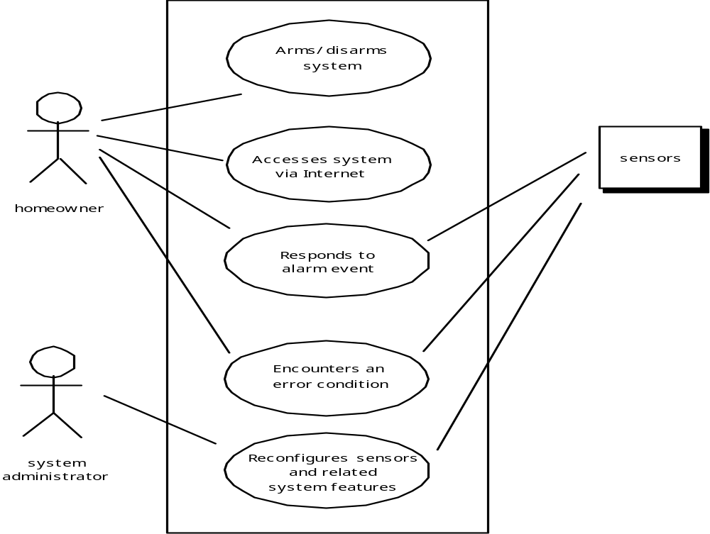
Use-Case Diagram

Slide 15
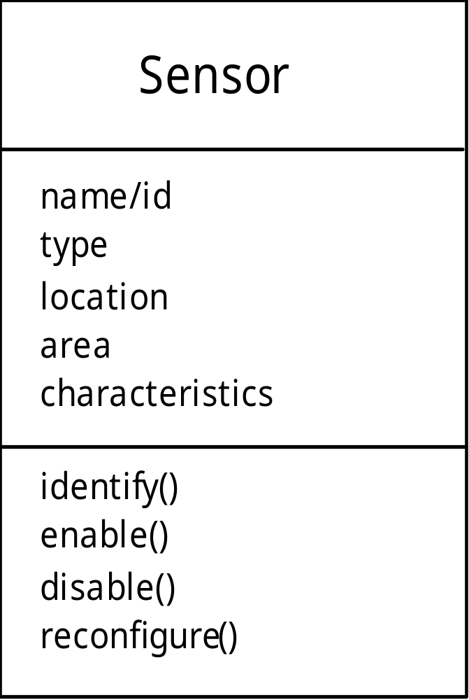
Class Diagram
From the SafeHome system …

Slide 16
State Diagram
Reading
Commands
State name
System status = “ready”
Display msg = “enter cmd”
Display status = steady
State variables
Entry/subsystems ready
Do: poll user input panel
Do: read user input
Do: interpret user input
State activities

Slide 17
Analysis Patterns
  Pattern name: A descriptor that captures the essence of the pattern.
  Intent: Describes what the pattern accomplishes or represents
  Motivation: A scenario that illustrates how the pattern can be used to address the problem.
  Forces and context: A description of external issues (forces) that can affect how the pattern is used and also the external issues that will be resolved when the pattern is applied.
  Solution: A description of how the pattern is applied to solve the problem with an emphasis on structural and behavioral issues.
  Consequences: Addresses what happens when the pattern is applied and what trade-offs exist during its application.
  Design: Discusses how the analysis pattern can be achieved through the use of known design patterns.
  Known uses: Examples of uses within actual systems.
  Related patterns: On e or more analysis patterns that are related to the named pattern because (1) it is commonly used with the named pattern; (2) it is structurally similar to the named pattern; (3) it is a variation of the named pattern.

Slide 18
Negotiating Requirements
Identify the key stakeholders
  These are the people who will be involved in the negotiation
Determine each of the stakeholders “win conditions”
  Win conditions are not always obvious
Negotiate
  Work toward a set of requirements that lead to “win-win”

Slide 19
Validating Requirements - I
Do any requirements conflict with other requirements?
Is each requirement consistent with the overall objective for the system/product?
Is each requirement bounded and unambiguous?
Have all requirements been specified at the proper level of abstraction? That is, do some requirements provide a level of technical detail that is inappropriate at this stage?
Is the requirement really necessary or does it represent an add-on feature that may not be essential to the objective of the system?
Does each requirement have attribution? That is, is a source (generally, a specific individual) noted for each requirement?

Slide 20
Validating Requirements - II
Is each requirement testable, once implemented?
Is each requirement achievable in the technical environment that will house the system or product?
Does the requirements model properly reflect the information, function and behavior of the system to be built.
Has the requirements model been “partitioned” in a way that exposes progressively more detailed information about the system.
Have requirements patterns been used to simplify the requirements model. Have all patterns properly validated? Are all patterns consistent with customer requirements?

Slide 21
Requirements Analysis
Requirements analysis
  specifies software’s operational characteristics
  indicates software's interface with other system elements
  establishes constraints that software must meet
Requirements analysis allows the software engineer (called an analyst or modeler in this role) to:
  elaborate on basic requirements established during earlier requirement engineering tasks
  build models that depict user scenarios, functional activities, problem classes and their relationships, system and class behavior, and the flow of data as it is transformed.

Slide 22
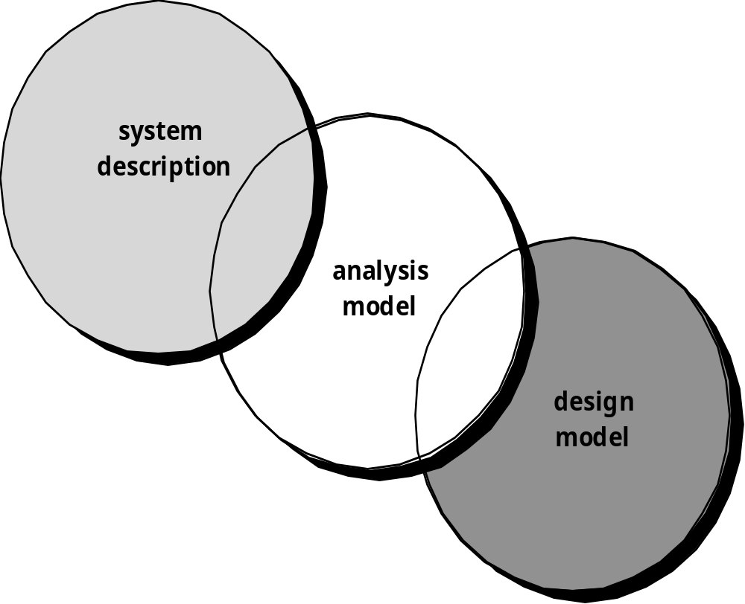
A Bridge

Slide 23
Rules of Thumb
The model should focus on requirements that are visible within the problem or business domain.
The level of abstraction should be relatively high.
Each element of the analysis model should add to an overall understanding of software requirements and provide insight into the information domain, function and behavior of the system.
Delay consideration of infrastructure and other non-functional models until design.
Minimize coupling throughout the system.
Be certain that the analysis model provides value to all stakeholders.
Keep the model as simple as it can be.

Slide 24
Domain Analysis
Software domain analysis is the identification, analysis, and specification of common requirements from a specific application domain, typically for reuse on multiple projects within that application domain . . .
The identification, analysis, and specification of common, reusable capabilities within a specific application domain, in terms of common objects, classes, subassemblies, and frameworks . . .
Donald Firesmith

Slide 25
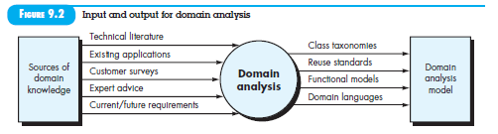
Domain Analysis
Define the domain to be investigated.
Collect a representative sample of applications in the domain.
Analyze each application in the sample.
Develop an analysis model for the objects.

Slide 26
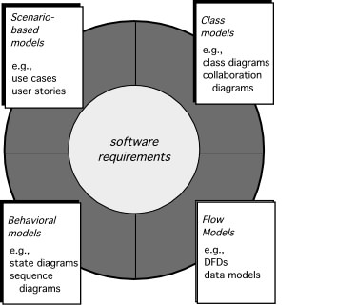
Requirement modeling Approaches
Elements of Requirements Analysis
END

